Slide 1
Secure Data Hiding in images using steganography
CAPSTONE PROJECT
Presented By: Aaditya Rajput
Student Name : Aaditya Rajput
College Name & Department : Hasmukh Goswami College Of Engineering (Computer Engineering)

Slide 2
OUTLINE
Problem Statement
Technology used
Wow factor
End users
Result
Conclusion
Git-hub Link
Future scope

Slide 3
Problem Statement
In the digital age, securely transmitting sensitive information is crucial. Traditional encryption methods can be complex, and sending plain text messages over unsecured channels poses security risks. This project aims to implement image-based steganography using Python and OpenCV, where users can hide secret messages within an image and retrieve them using a passcode.

Slide 4
Technology used
Python – Primary programming language for implementing the steganography logic.
OpenCV – Used for image processing and pixel manipulation.
Tkinter – Provides a simple GUI for user interaction (message input, passcode entry, and alerts).
OS Module – Helps in opening the encrypted image automatically based on the operating system.
ASCII Encoding – Converts text into numerical values to be embedded in the image pixels.

Slide 5
Wow factors
The wow factor of this project lies in its ability to hide secret messages inside images without anyone noticing! It’s super easy to use, with a simple GUI for encryption and decryption. Plus, password protection ensures only the right person can access the hidden message. No extra files are needed since the text is stored directly in the image pixels. Whether for fun or security, this project makes secret communication cool.

Slide 6
End users
This project is designed for cybersecurity enthusiasts, privacy-conscious users, and students who want to explore steganography and secure communication. It’s also useful for educators teaching cryptography, developers looking to expand on image-based encryption, and even mystery lovers who enjoy hidden messages. Whether for fun or security, this tool provides a simple yet powerful way to share confidential information without drawing attention.

Slide 7
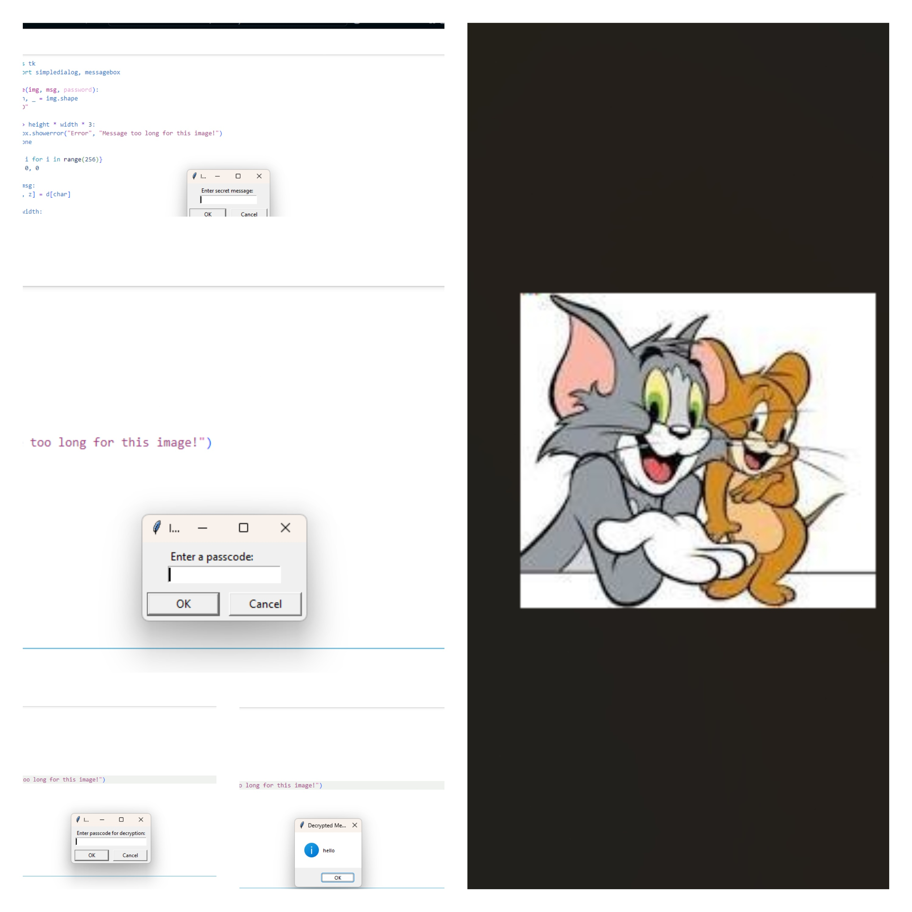
Results

Slide 8
Conclusion
This project demonstrates a creative and secure way to hide messages inside images using steganography. With a simple GUI, password protection, and seamless encryption, it makes secret communication easy and effective. Whether for learning, privacy, or fun, this tool showcases how technology can be used for secure and hidden data transfer. It’s a perfect blend of innovation, security, and simplicity!

Slide 9
GitHub Link
https://github.com/Aaditya-19/Steganography.git

Slide 10
Future scope(optional)
This project has great potential for further enhancements. Future improvements could include stronger encryption algorithms for added security, support for different file formats like audio and video, and optimized storage techniques to hide larger messages without affecting image quality. Advanced AI-based steganography could make the hidden data even more undetectable. Additionally, developing a mobile or web-based application would make this tool more accessible and user-friendly. With these upgrades, the project could become a powerful and versatile steganography tool for secure communication!

Slide 11
THANK YOU

